Slide 1






Hello!
San Francisco

Slide 2
At CityTroops we help companies to
better manage their field teams and operations, improving their efficiency in more than 91%
www.CityTroops.com | rodrigorodriguez@citytroops.com

Slide 3
We know where it hurts
More than 70% of companies worldwide
have a terrible problem
www.CityTroops.com | rodrigorodriguez@citytroops.com

Slide 4
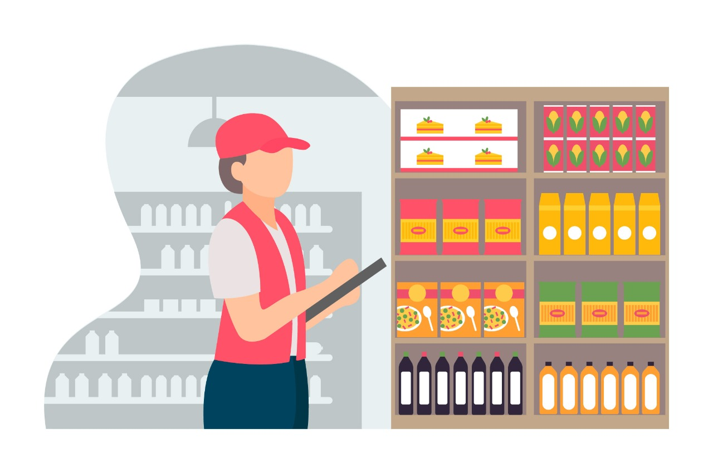
The Pain:
Companies don’t know what is happening with their
teams, information
and operations
in the streets.
www.CityTroops.com | rodrigorodriguez@citytroops.com

Slide 5
The real issue:
Companies don’t
provide with proper tools to field employees
(They still use pen and paper, whatsapp and Excel)
www.CityTroops.com | rodrigorodriguez@citytroops.com

Slide 6






The traditional flow of a company (daily operations):
1) 7:00 – 7:30
employee commutes
to the office
2) 7:30 – 7:50
Gets a list of clients
to visit
3) 7:50 – 8:30
Manual routing
and moves to zone
4) 8:30 + Visits 30 clients
or stores.
10 min / visit
5) Manually
transcript
data collected
(30 min)
(20 min)
(40 min)
(300 min -
5 hours )
(180 min –
3 hours)
Companies are wasting more than 390 min (6.5 hours)
/ employee / day
100 employees = 13.000 hours = € 78.000 wasted per month
www.CityTroops.com | rodrigorodriguez@citytroops.com

Slide 7
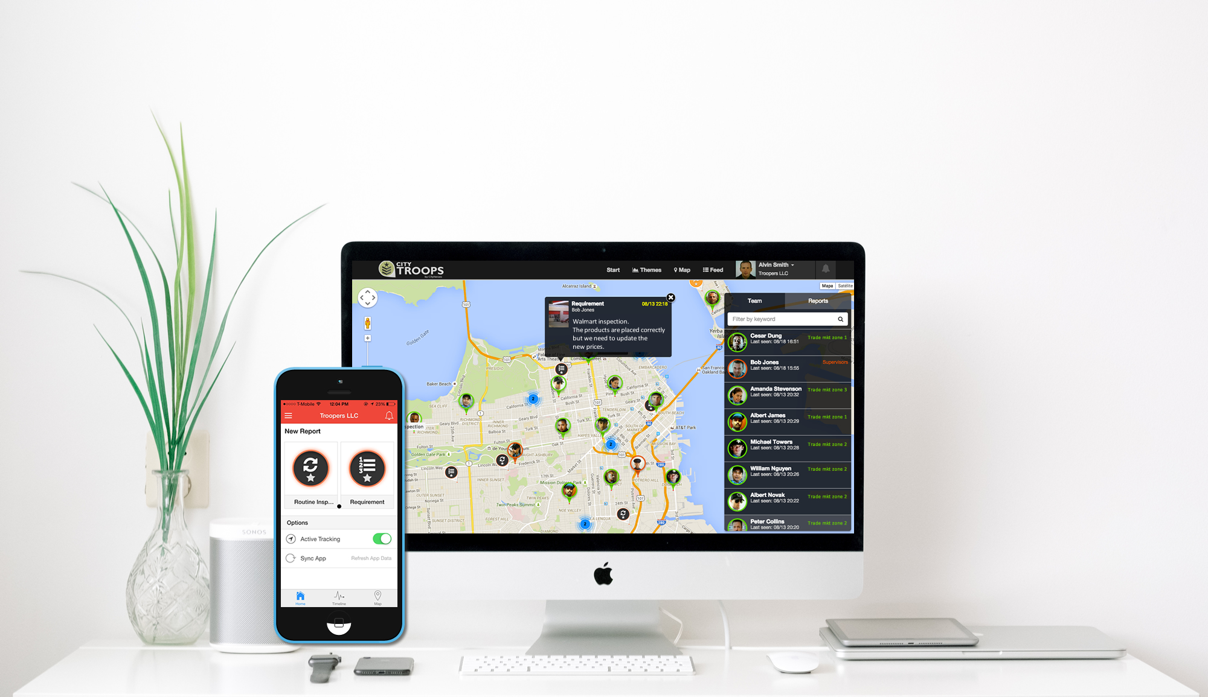
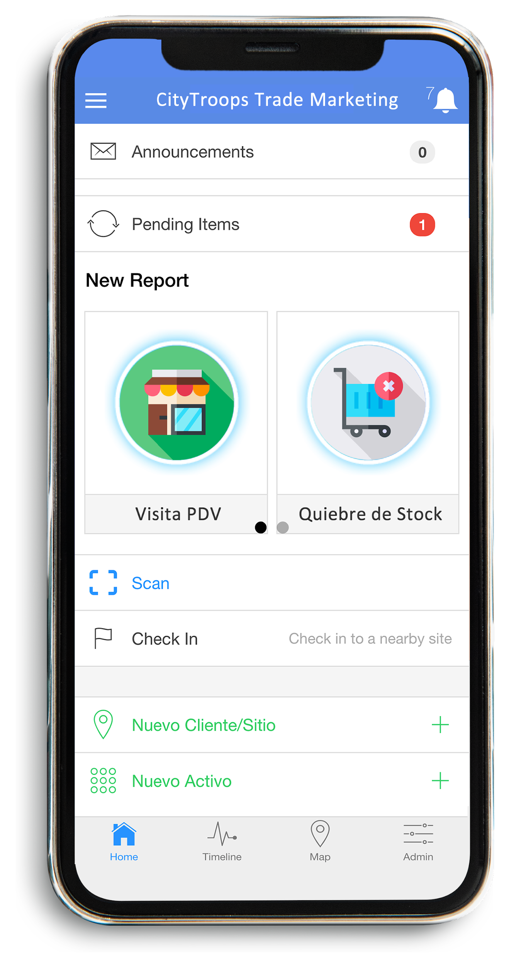

90% of companies have this problem:
Organizing workforce, tools and activities for an efficient field execution is chaotic!

Slide 8
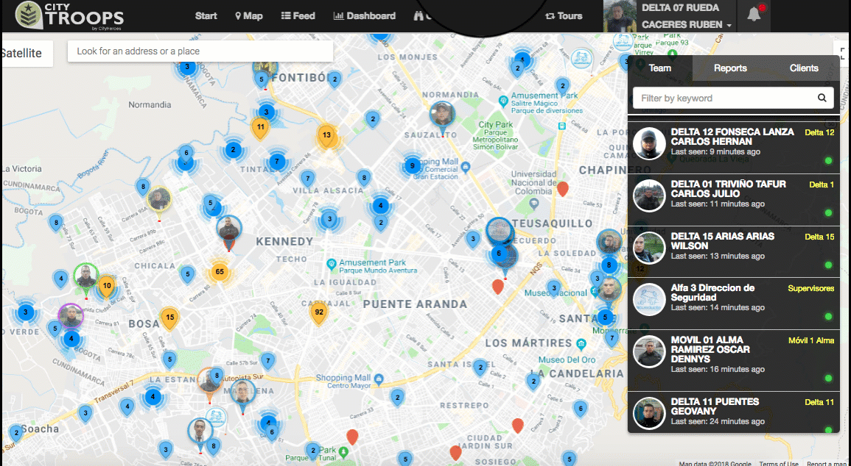
Check-in at zone and real time coverage
1) 7:00 – 7:30
employee commutes
to the office
+ 30 min

Slide 9
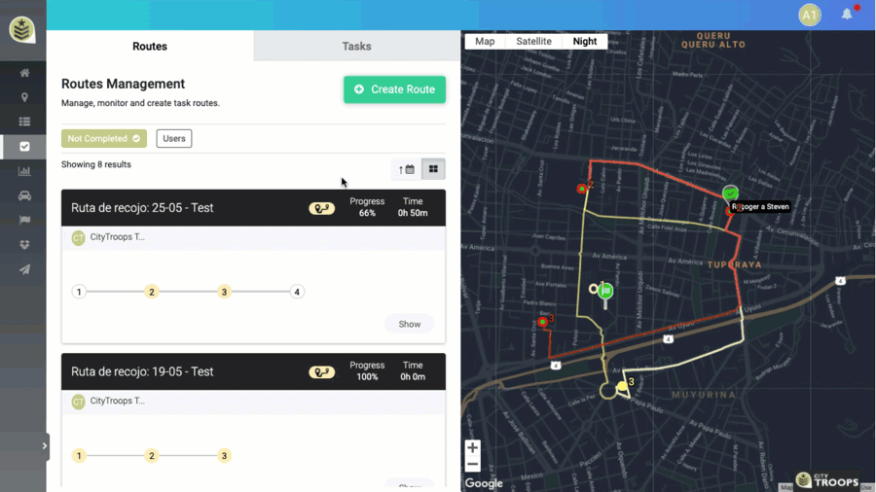
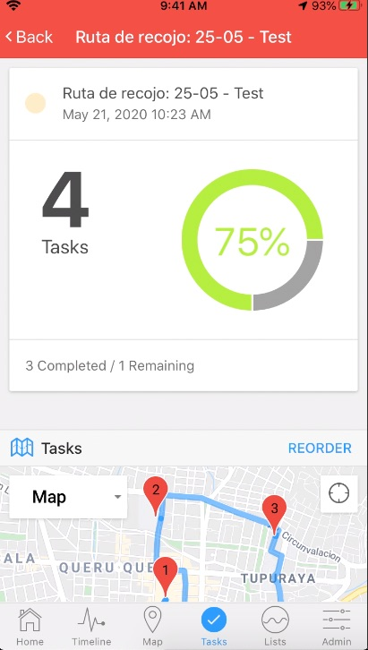
Optimized tasks and routing
2) Gets a list of
clients
to visit
3) Manual
routing
+ 40 min

Slide 10
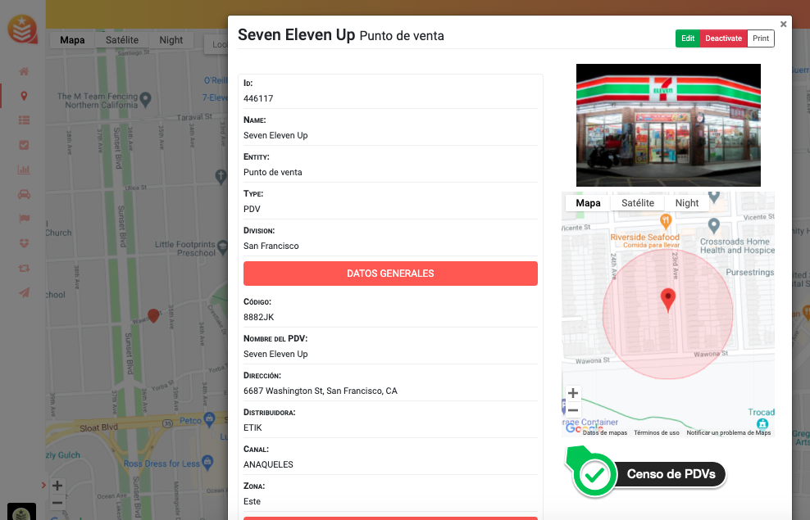
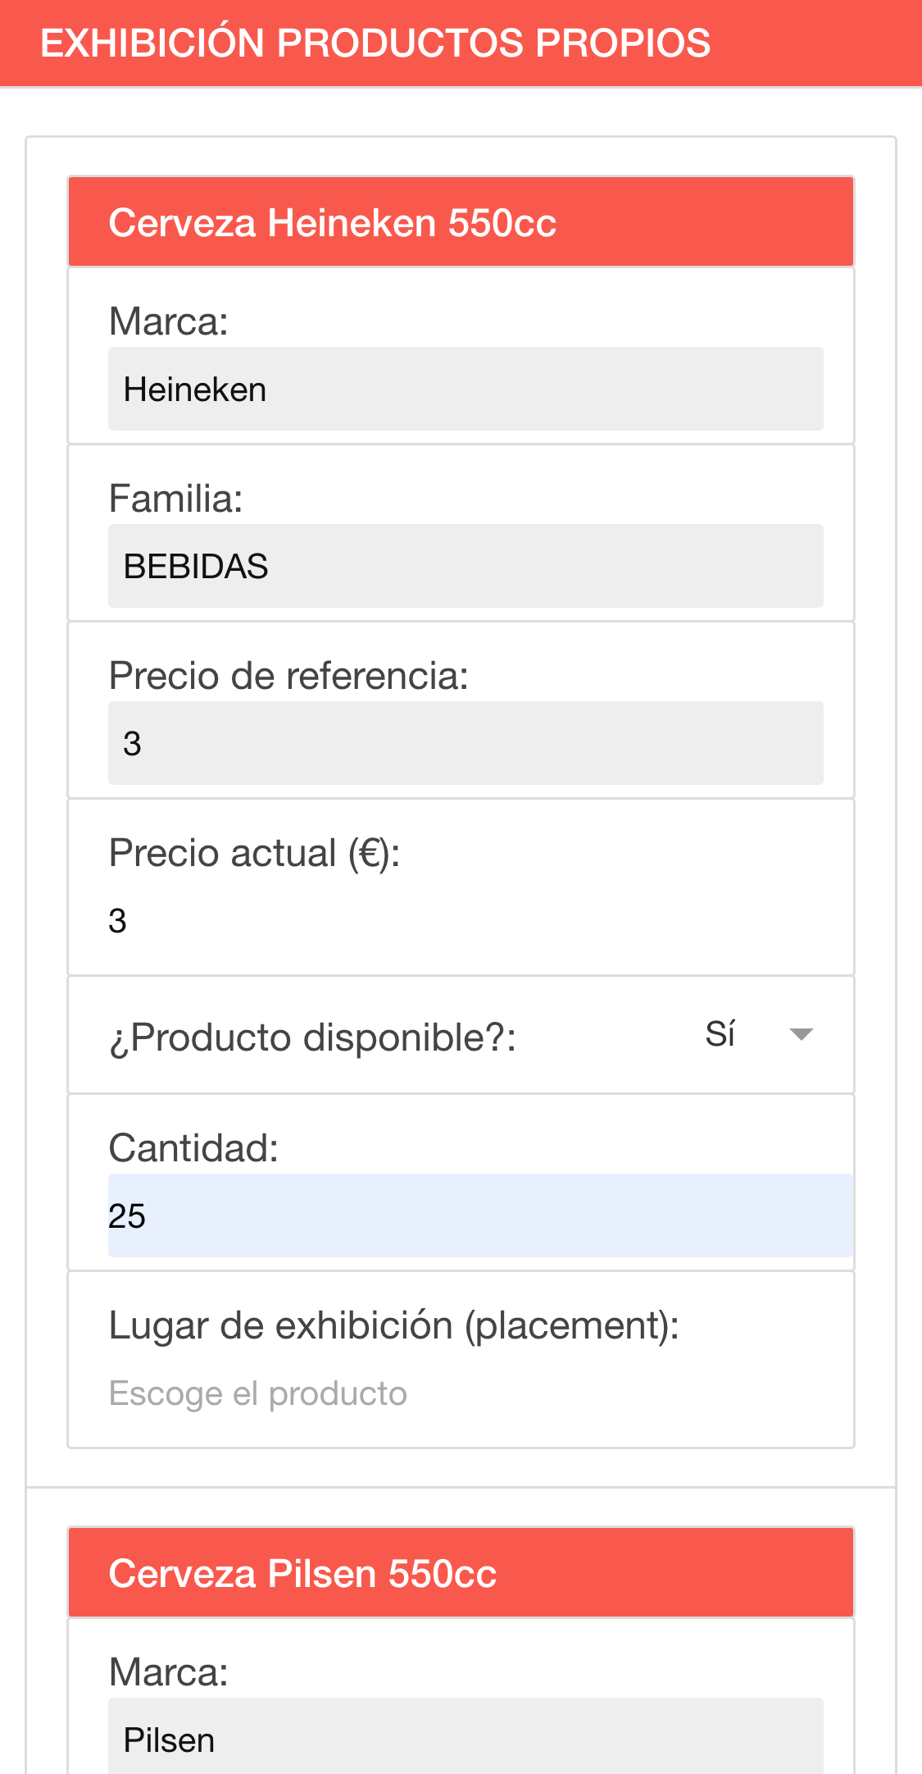
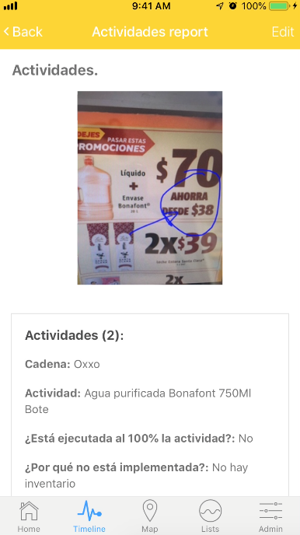
Collect data in real time, easy and fast
+ 150 min
or 1.5 hours

Slide 11
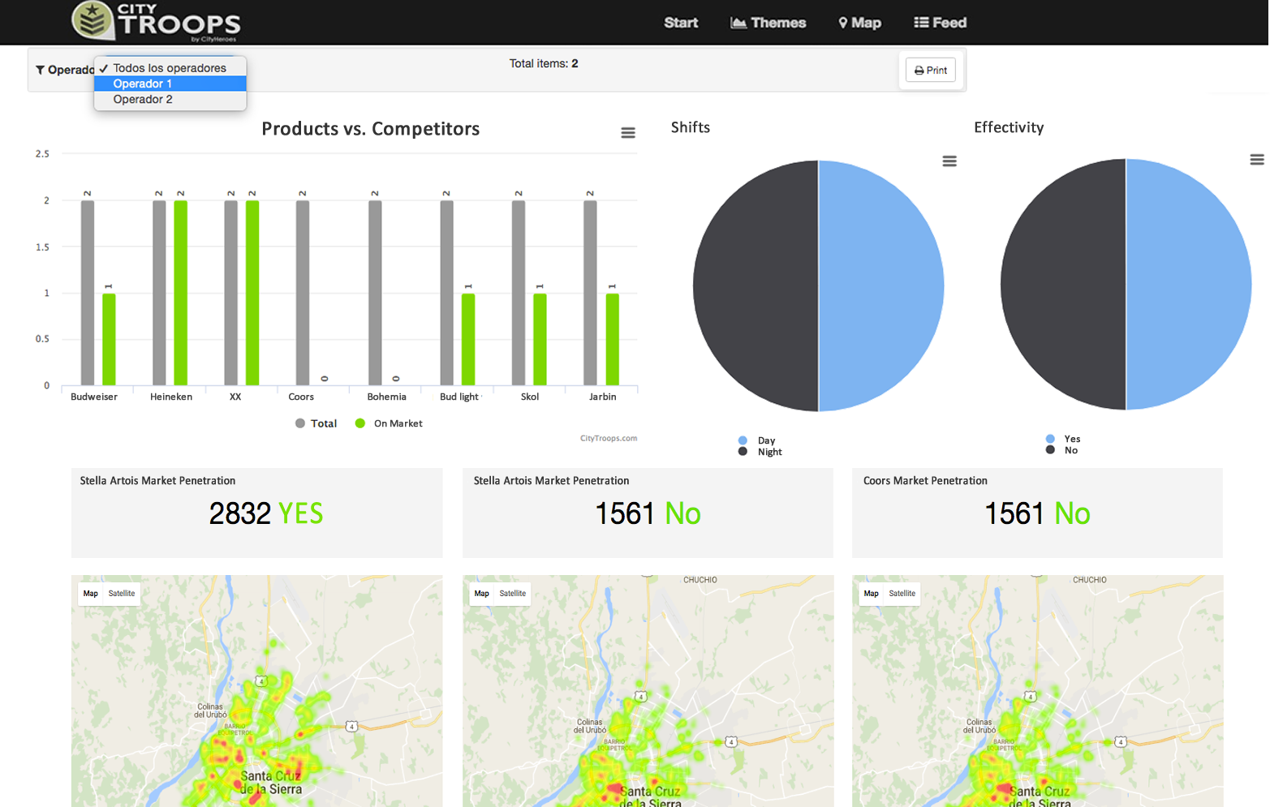
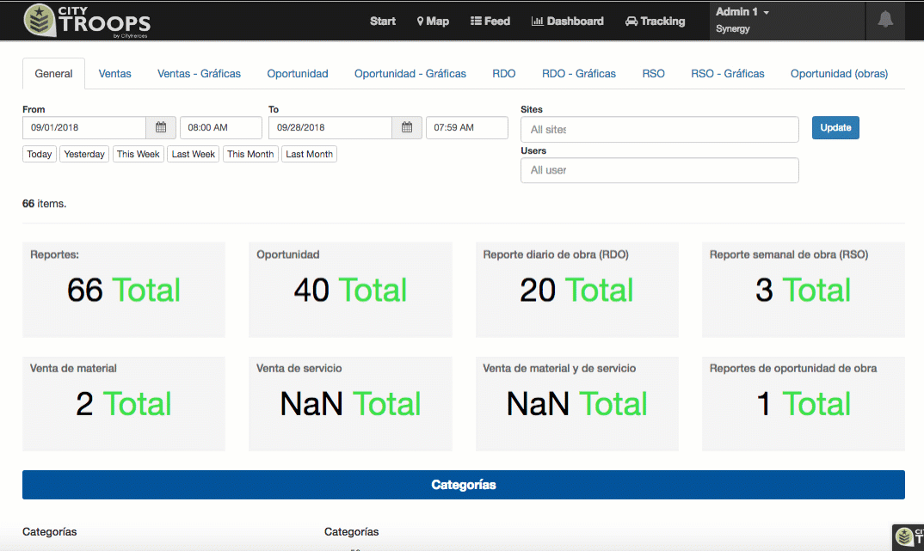
Tables, metrics and analytics fully processed
5) Manually
transcript
data collected
+ 180 min
or 3 hours

Slide 12
With CityTroops:
1) 7:00 – 7:30
employee commutes
to the office
2) 7:30 – 7:50
Gets a list of clients
to visit
3) 7:50 – 8:30
Manual routing
and moves to zone
4) Visits 30+ clients
or stores.
5 min / visit
5) Manually
transcript
data collected
(30 min)
(20 min)
(40 min)
(150 min -
1.5 hours )
(180 min –
3 hours)
Companies optimize at least 6.5 hours
per employee / day
With less than $1 /user/day
www.CityTroops.com | rodrigorodriguez@citytroops.com

Slide 13




































Some of our customers worldwide:

Slide 14


We have the rocket,
let’s fly together!
www.CityTroops.com
rodrigorodriguez@citytroops.com

Slide 15
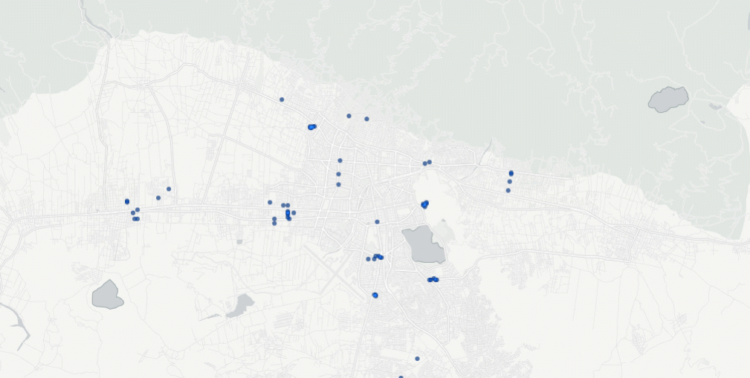
Our traction so far:
8.000.000+
$us 5.000.000+
2500+
reports sent through CityTroops
saved for our customers
field employees
and assets
Clients in
countries
3.000.000+
91%
18+
hours saved for the field workforce
efficiency improvement avg.

Slide 16
Why we are different:
Powerful technology and API
Totally flexible and 100% customizable for any industry or area of the company.
Extremely easy to use and friction free. No training or manuals needed.
Focused on experience and service (our clients love our personalized service).

